Slide 1
Under the guidance of: mr. ramesh k t be submitted by: anusha a v 485cs17002 bhoomika b s 485cs17006 kavana basavaraj 485cs17016 kavana m 485cs17017 kavana s p 485cs17018
SREE SIDDARAMESHWARA POLYTECHNIC
ALUMNI REUNION APPLICATION

Slide 2
ABSTRACT
College alumni reunion app which allows outgoing students and new students of a college to communicate with each other.
The students can ask about career, job vacancies and subject details with outgoing students.

Slide 3
EXISTING SYSTEM
Currently all colleges maintain present and outgoing students manually.
Re collecting this data in the manual system is very difficult.
If student needs any data about outgoing students they have to approach college management.
Overall collecting the information is very tedious task in this system.

Slide 4
PROPOSED SYSTEM
This project allows students to register through online.
The students can easily access outgoing student’s data.
Students can directly communicate with outgoing students regarding Job, or any enquiry.
Outgoing students can update job opportunity and give references to new students.
College management can post the announcement.

Slide 5
HARDWARE SYSTEM CONFIGURATION
Processor - Intel(R)
RAM - 2 GB(min)
Hard Disk - 80 GB

Slide 6
SOFTWARE REQUIREMENTS
Operating System : Windows 7
Server : Tomcat 7 above
Coding Language : HTML, Java
Scripts : JavaScript
Server side Script : Java Server Pages
Database : MySQL

Slide 7
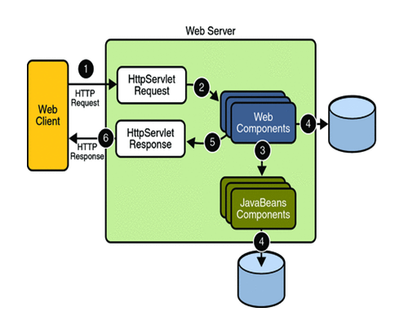
ARCHITECTURE DIAGRAM

Slide 8
MODULES
Admin
Alumni
Student

Slide 9
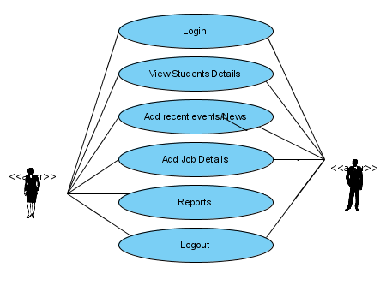
ADMIN

Slide 10
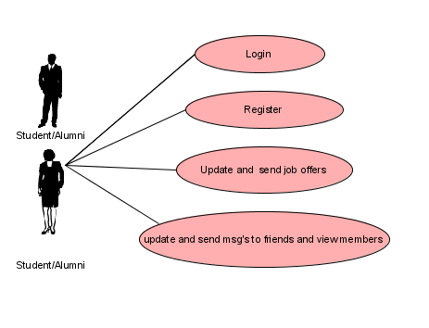
ALUMNI / STUDENT

Slide 11
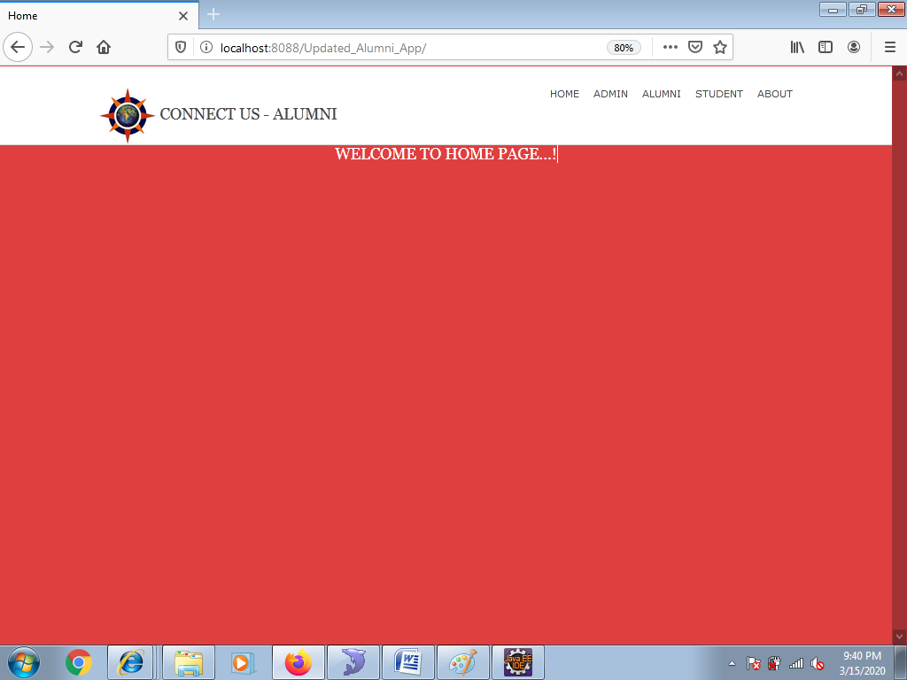
SNAPSHOTS

Slide 12
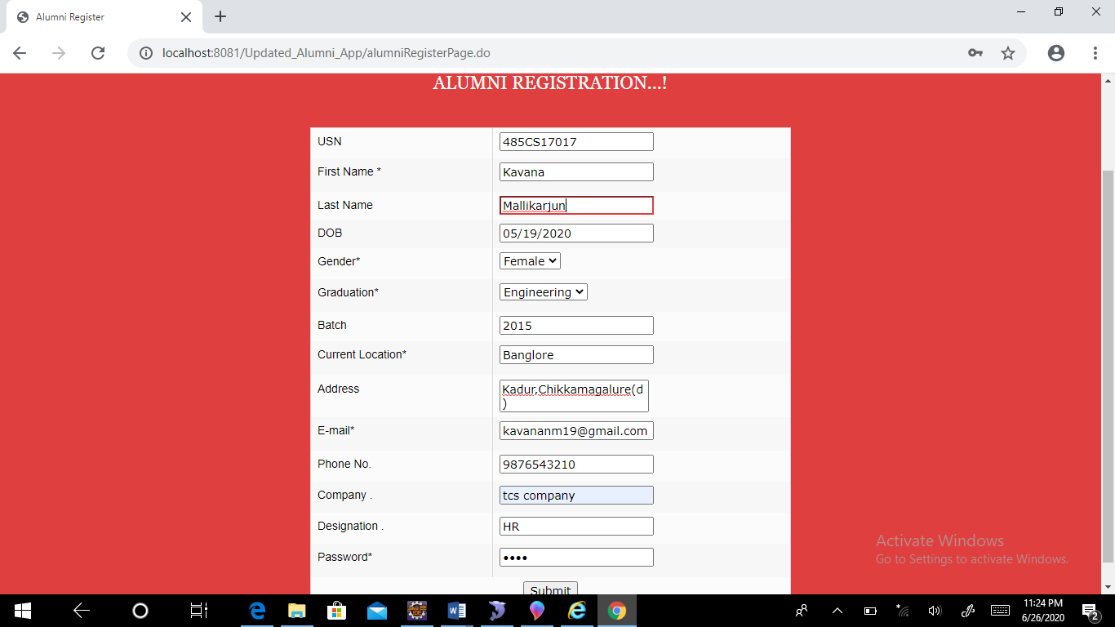

Slide 13
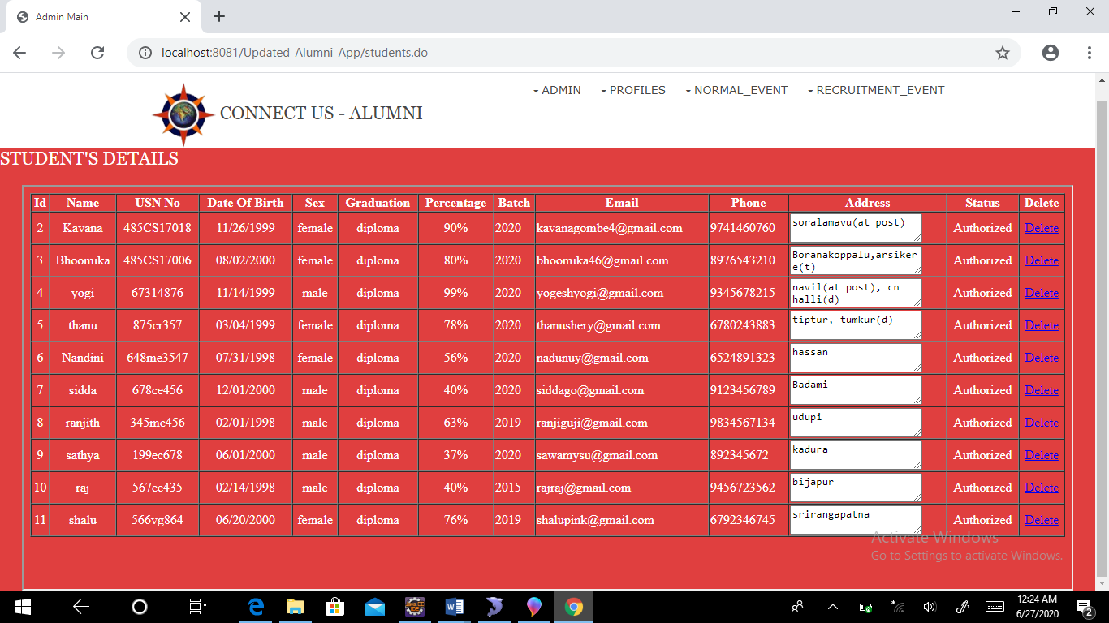

Slide 14
ADVANTAGES
Ensure that alumni stay connected to the campus by sharing news, athletic and video feeds as well as social media channels
Provide alumni newsletters, event invitations and magazines in digital form.
Allow users to stay connected to each other with a mobile alumni directory.
Provide specific career opportunities for alumni.

Slide 15
CONCLUSION
Alumni Information Database is mainly used to share the views between the users of the application which is very useful to upgrade the knowledge of everyone.
The application is also serve as a useful site to know what is going on in our college and can also know about the various opportunities of the outer world.

Slide 16


